Slide 1
OiRA

Slide 2




OiRA
Free!
Open source
Software +
anonymous

Slide 3









How we work with our partners
EU-OSHA
Support
17 languages
OiRA tools generator
National
OiRA Partners
Small & micro
enterprises
Tools

Slide 4
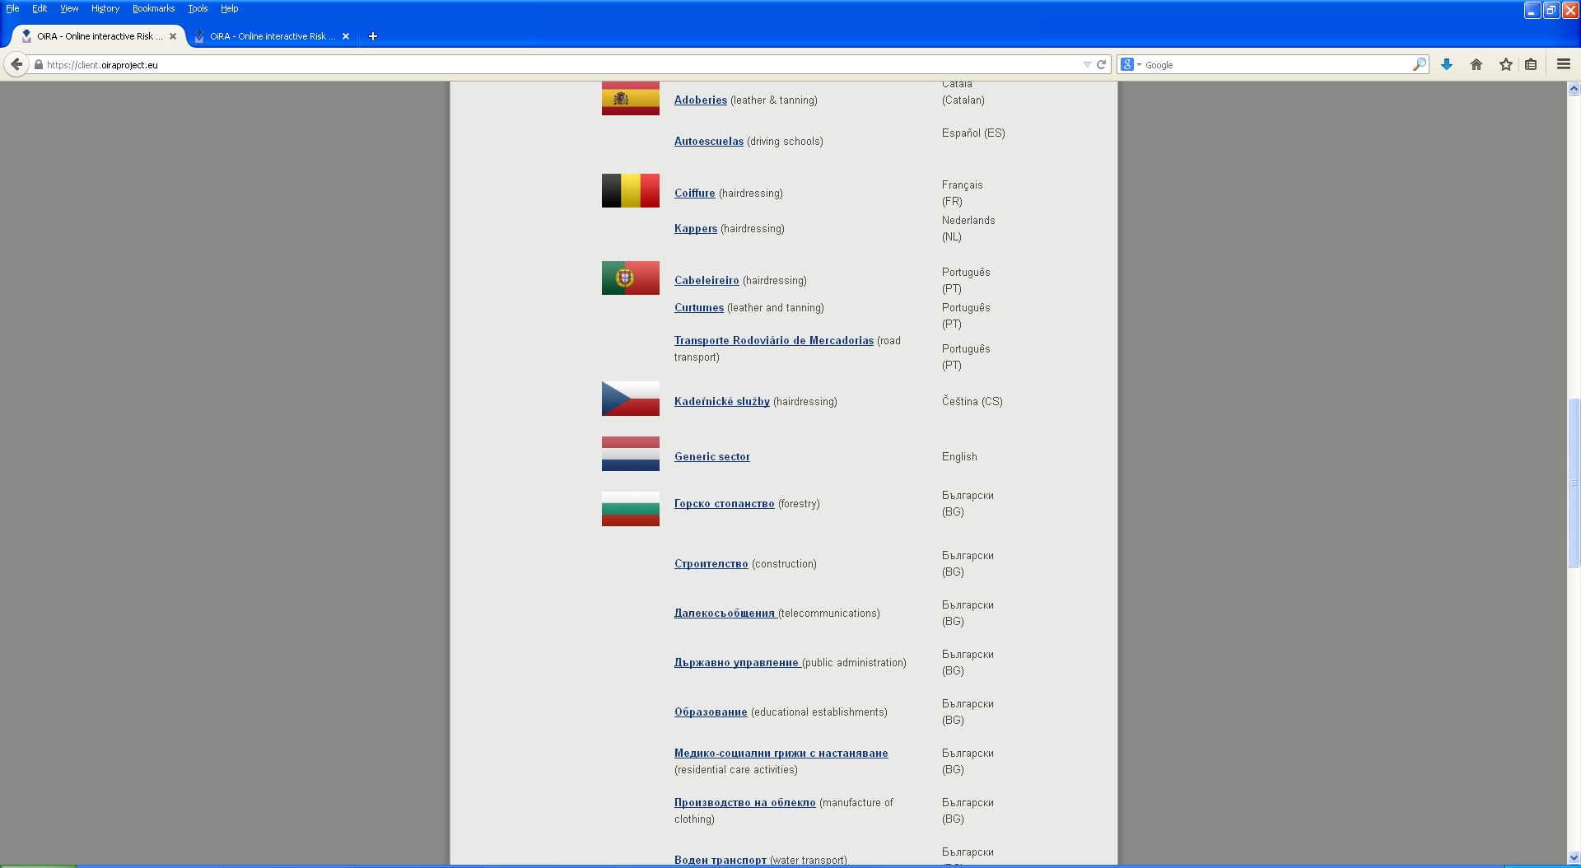
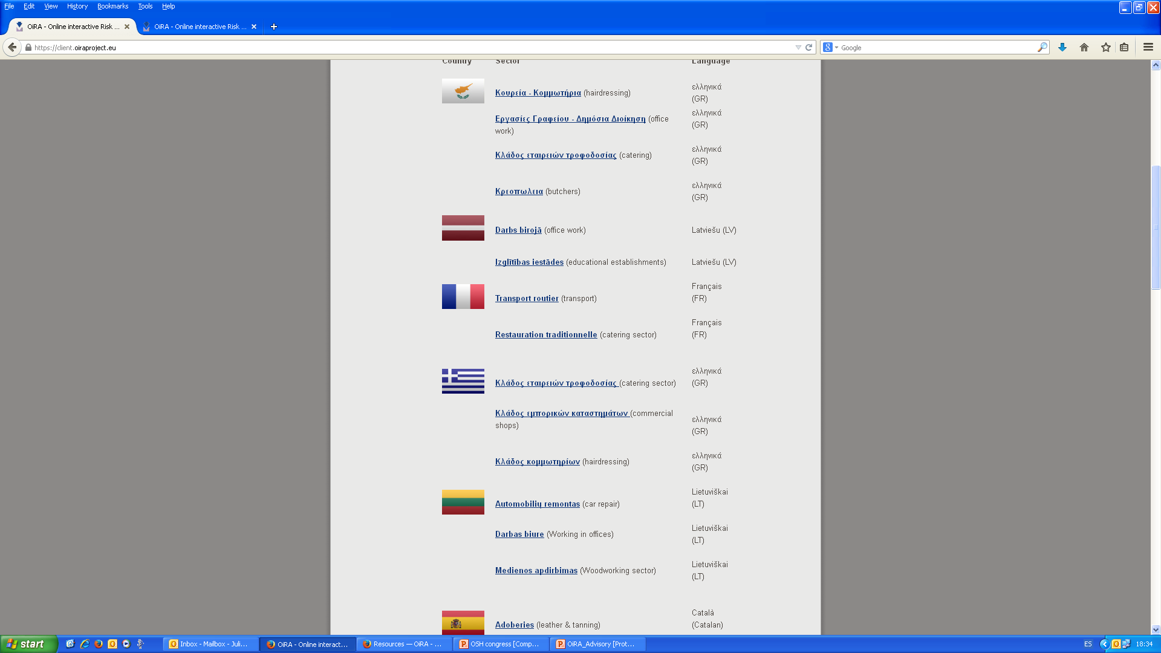



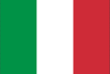






OiRA partners at national level
Portugal
Slovakia
Slovenia
Spain
Croatia
Belgium
Bulgaria
Cyprus
Czech Republic
France
Finland
Greece
Iceland
Italy
Latvia
Lithuania
Malta

Slide 5



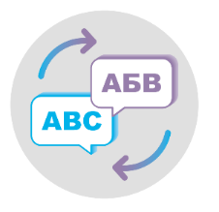

OiRA target groups – EU level
EU-OSHA
OiRA tools generator
EU Sectoral
Social Dialogue
General
EU Tool
National OiRA
& Social Partners
National
Tool
Small & micro
enterprises

Slide 6

OiRA target groups – general
EU-Social
Dialogue
43 sectors
Already on board: private security, live performance, leather and tanning, hairdressers, cleaning, sports, HORECA, education, audiovisual, agriculture
Member States &
EFTA Countries
Open to all 27 EU Member states and EFTA countries and EU accession candidates
Ministries & Health and Safety Authorities
Public Health and Safety Institutes
Social partners (if EU SSD tool exists)
Small & micro
enterprises
ca. 19 million small and micro enterprises (1-50 employees)

Slide 7






What we expect from OiRA partners
Accepting OiRA Philosophy
Development of instruments
Involvement of social partners
Expert validation
Promotion of tools
Maintenance

Slide 8
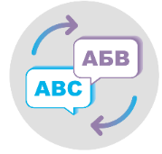






EU-OSHA support for OiRA partners
Translation of the software
Hosting & maintenance
Financial support
OiRA Community
Training & Helpdesk for partners
Support for promotion
OiRA library

Slide 9

More information:
http://www.oiraproject.eu
Contact:
flintrop@osha.europa.eu
palmer@osha.europa.eu
seifert@osha.europa.eu

